Slide 1
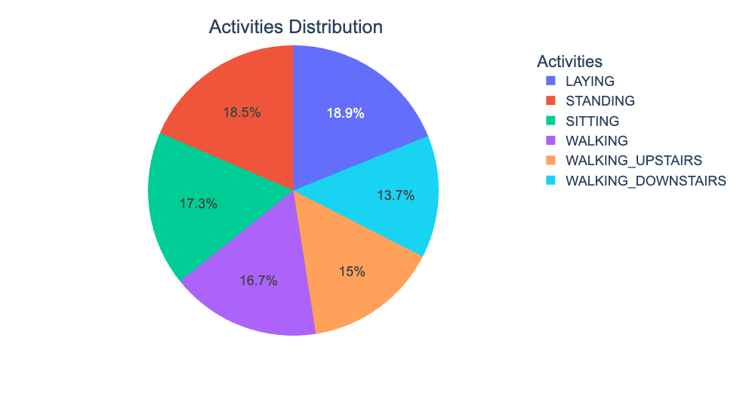
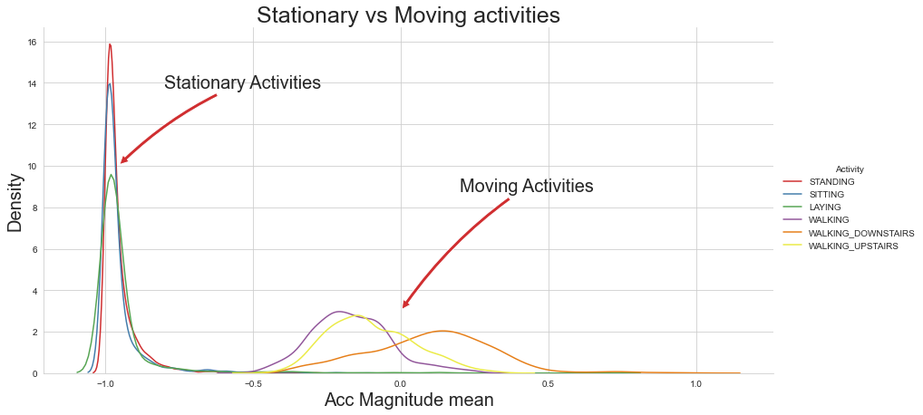
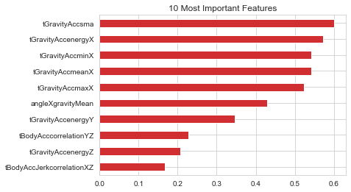
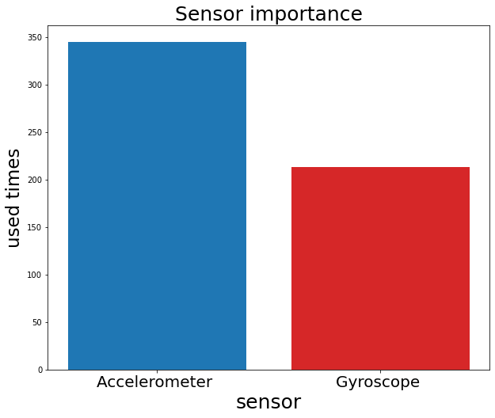
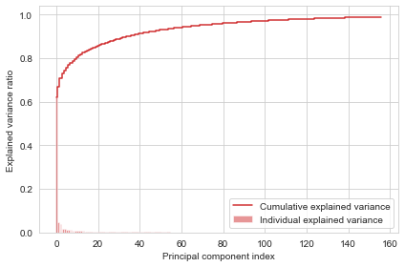
Human Activity Recognition using Machine Learning
Introduction
Human activity recognition is a field of study that involves using various sensors and machine learning techniques to analyze and understand human activities. This technology has many potential applications in areas such as healthcare, sports, security and entertainment.
The global market for HAR is expected to reach $12.7 billion by 2025.
The exact numbers for the potential benefits of HAR in these areas vary, but they are significant. For example, a study by the University of California, Berkeley found that HAR could save the healthcare system $150 billion per year by improving the diagnosis and treatment of chronic diseases. And a study by the University of Cambridge found that HAR could improve the performance of athletes by up to 10%.
Data Description
Data Source: The data was publicly available in Kaggle. The database was built from the recordings of 30 study participants performing activities of daily living (ADL) while carrying a waist-mounted smartphone with embedded inertial sensors.
For each record in the dataset the following is provided:
Triaxial acceleration from the accelerometer (total acceleration) and the estimated body acceleration.
Triaxial Angular velocity from the gyroscope.
561-features vector with time and frequency domain variables.
An identifier of the subject who carried out the experiment.
One dependent variable, activity which is the final observation of human activities.
Results and Discussion
Support Vector Machines (SVM) has the highest accuracy of 97.8% compared to all others.
Logistic Regression ranks the second best.
Important features are Gravity accelerometer signal mag area, energy and min. The analysis identified the most important features for accurately predicting human activities, by considering accelerometer data, gyroscope data and time-related features.
These features provide valuable insights into the movements and patterns of human activities, such as walking, running and sitting.
Business Implications
This system could be used by healthcare professionals to make informed decisions based on the insights provided by the system, such as recommending specific exercises or activities for patients with certain medical conditions.
The developed system could potentially lead to improved health outcomes and quality of life for individuals across a wide range of domains.
Our algorithm can also be used to enhance virtual reality experiences by providing more immersive interactions between the user and the virtual environment.
Model Name | Accuracy | Precision | Recall | F1-Score
Logistic Regression | 98.15% | 98.15% | 98.15% | 98.15%
KNN | 94.4% | 94.4% | 94.4% | 94.4%
Naïve Bayes | 68.5% | 68.5% | 68.5% | 68.5%
SVM | 98.8% | 98.8% | 98.8% | 98.8%
Decision Tree | 93% | 93% | 93% | 93%
Future Studies
Apply same algorithms and methods on more detailed dataset to confirm the results obtained via this database.
I plan to apply other machine learning algorithms (Random Forest, XgBoost, etc) with more activity classes to obtain higher accuracy.
Additionally, I could explore the use of other sensor modalities such as heart rate monitors, GPS trackers, and cameras to capture additional information about human activities.
Data Pre-Processing
Principal Component Analysis (PCA) was performed to reduce the number of features to 157 from 561.
Conclusion
Our project collects data from Kaggle and preprocess the dataset
Careful feature selection and model optimization are important for model performance and evaluation metrics should be chosen based on problem requirements.
After an accurate comparison between our models, I found that Support Vector Machine achieved a higher efficiency and outperformed all other models.
This system could be used to monitor and analyze physical activity in elderly individuals to detect potential health risks or to improve sports performance by providing real-time feedback on technique and form.
Objective
Methodology
The project uses various machine learning models to identify the type of the activities.
To pre-process sensor signals to obtain features from both the time and frequency domains.
To create a classification model that can effectively differentiate between walking, walking upstairs, walking downstairs, sitting, standing and laying.
To evaluate the performance of the developed system using a test dataset.
To develop a system that accurately identifies six different human activities using data from wearable sensors.
Logistic Regression
K Nearest Neighbor (KNN)
Naïve Bayes
Support Vector Machine
Decision Tree Method
Bargavi Kongara

